Slide 1
Using the Smart Card
Michael Woodmansee

Slide 2
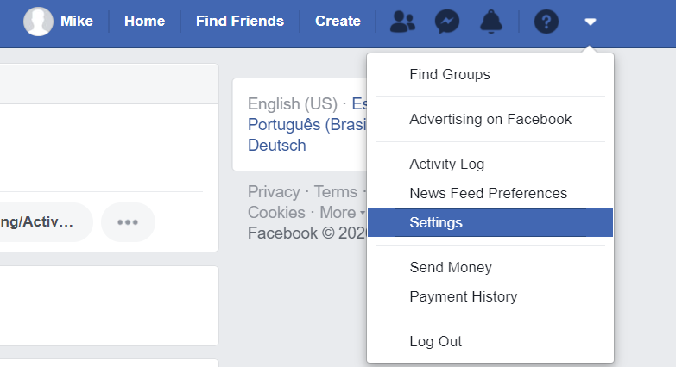
Finding the Settings
To find the settings go to the navbar on the top, on the right, click the drop down menu and click settings .

Slide 3
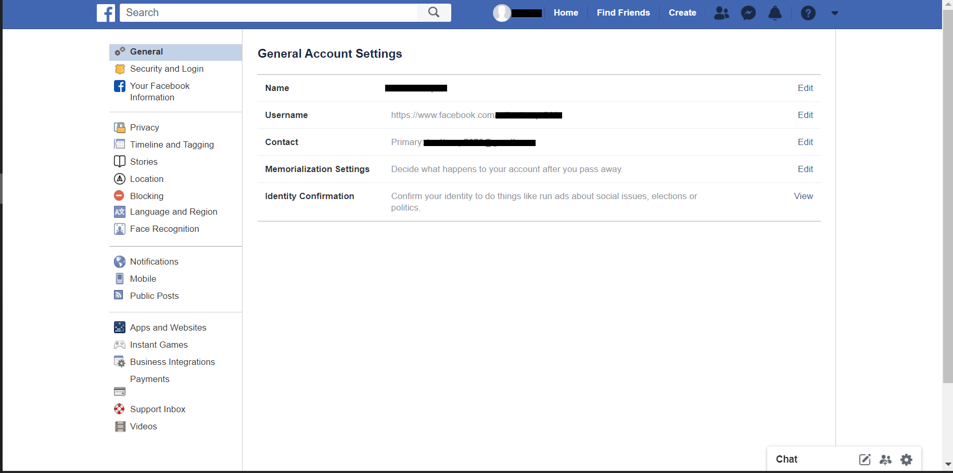
The Settings Page
On the Setting page you find a lot of useful tools including Blocking, the help section , security section, and privacy section. All of these section have links on the side bar.

Slide 4
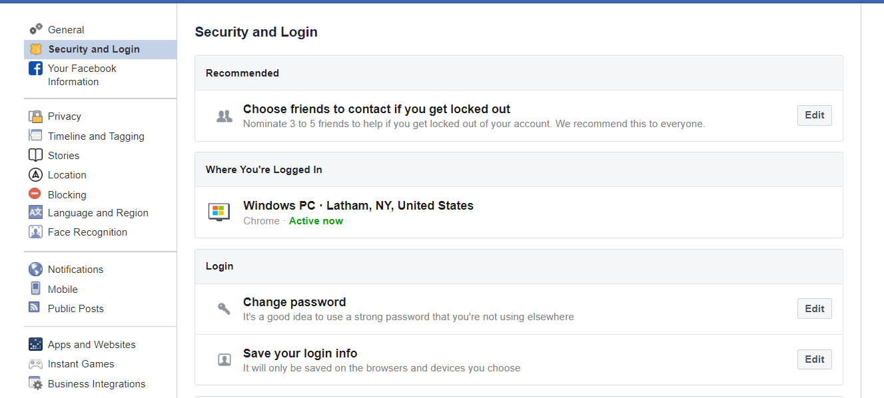
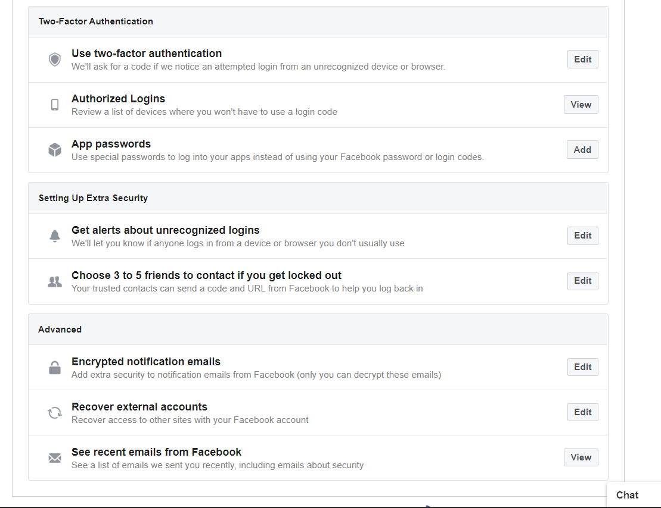
Security Section
The security section include features you should consider like two factor authentication, where your account is logged in, password management, account recovery setup, site tracker to see all the sites your account has been logged into.

Slide 5
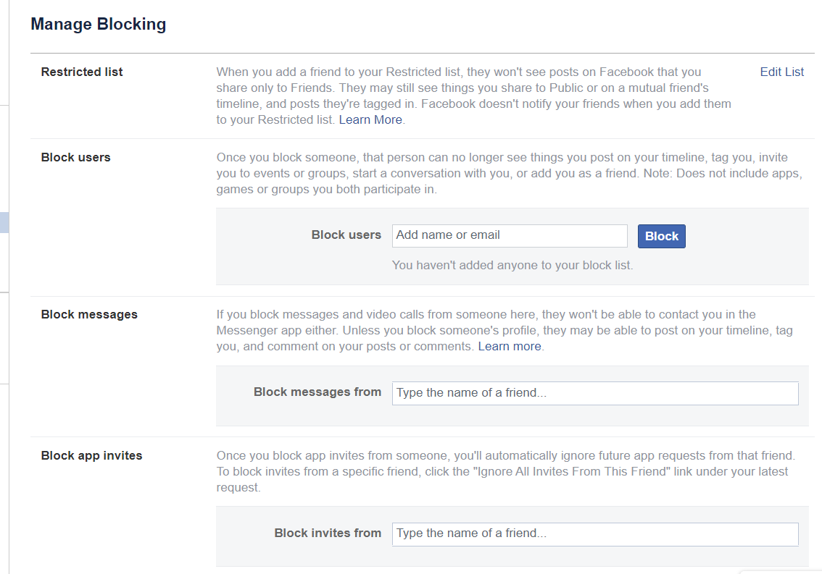
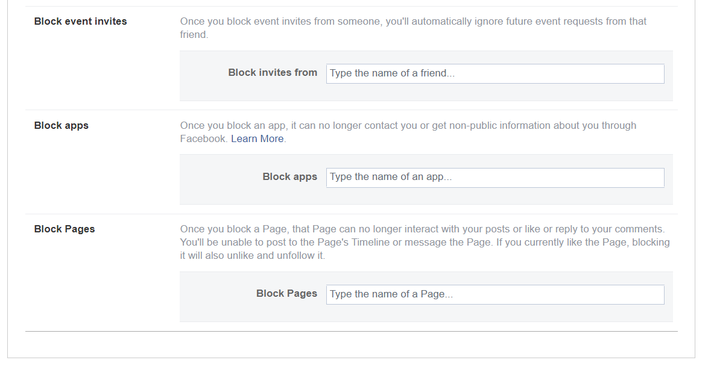
Blocking Section
The blocking section in the settings gives the user access to block not just other users, messages, but to block apps from getting “non public information” which means any data that is personal data , however they still have your email if that was used during the time you used the app. The blocking tool can be useful if the user take the time to set up.

Slide 6
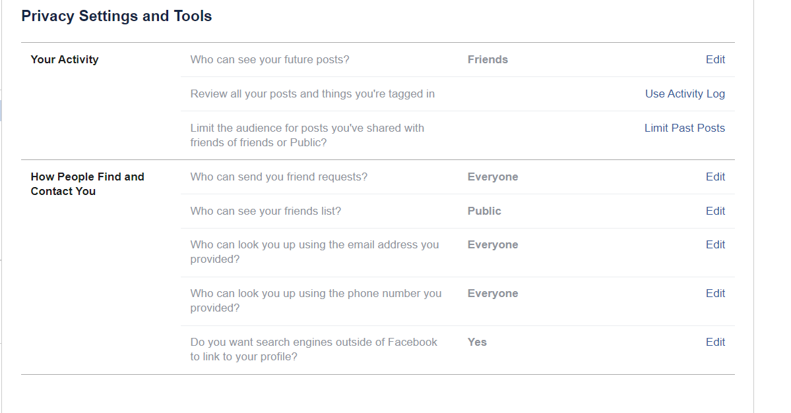
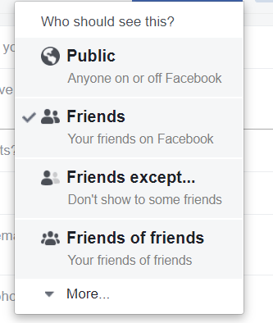
Privacy Section
This section is mainly for deciding who can see what personal information you put on the platform. The settings give the user options like Friends, Everyone, only yourself and friends of friends to limit who see what.

Slide 7
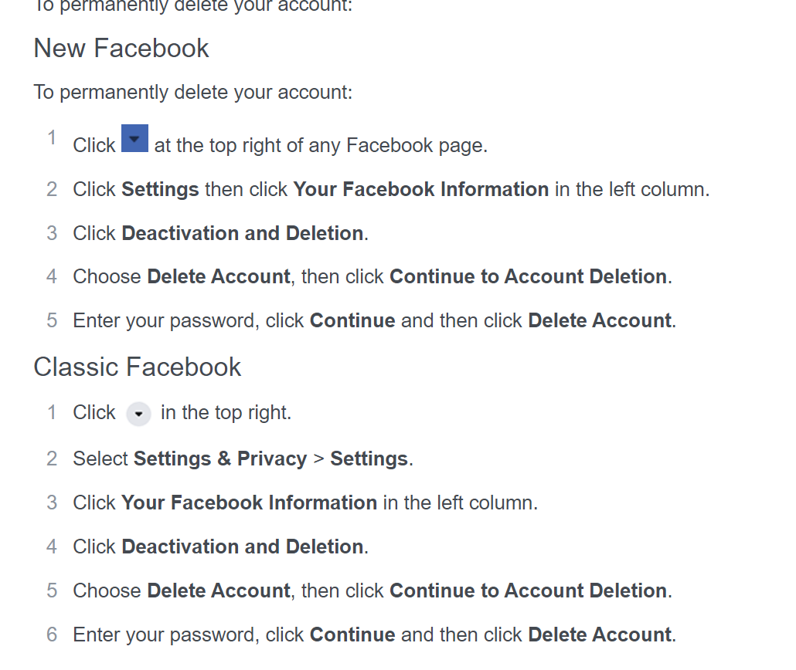
Deleting Account
In the settings under the “Your Facebook information” tab the user will see a option for deleting / deactivating.
In this section we will focus on deleting the account

Slide 8
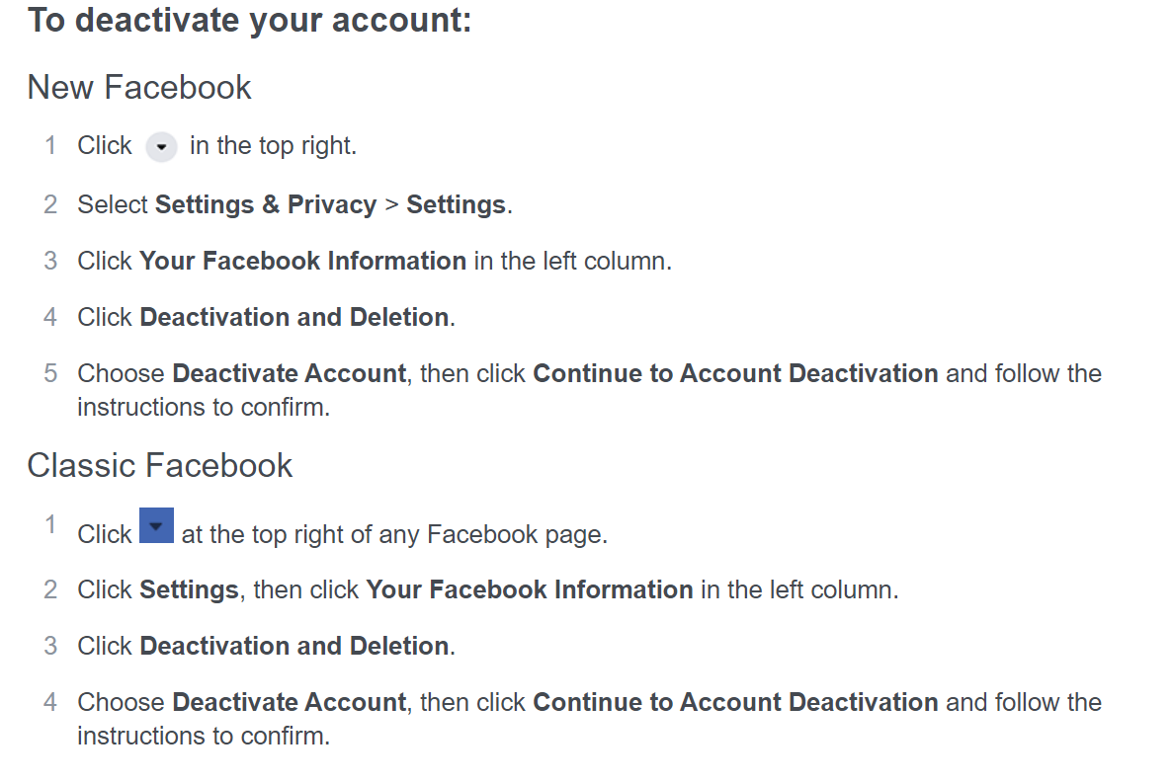
Deactivating Account
In the settings under the “Your Facebook information” tab the user will see a option for deleting / deactivating.
In this section we will focus on deactivating the account.

Slide 9
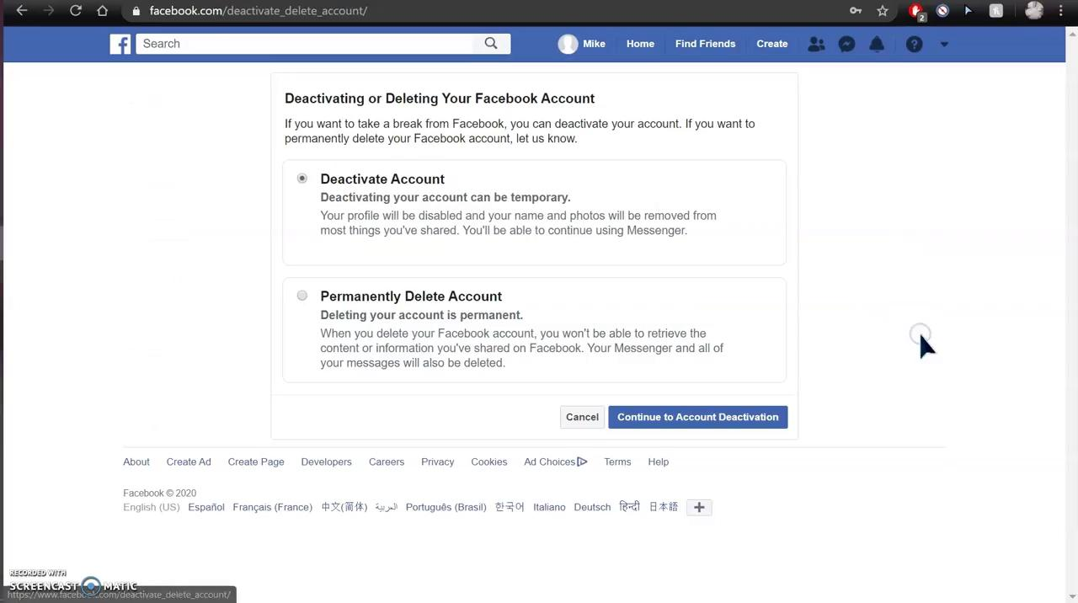
Deactivating Account Video

Slide 10
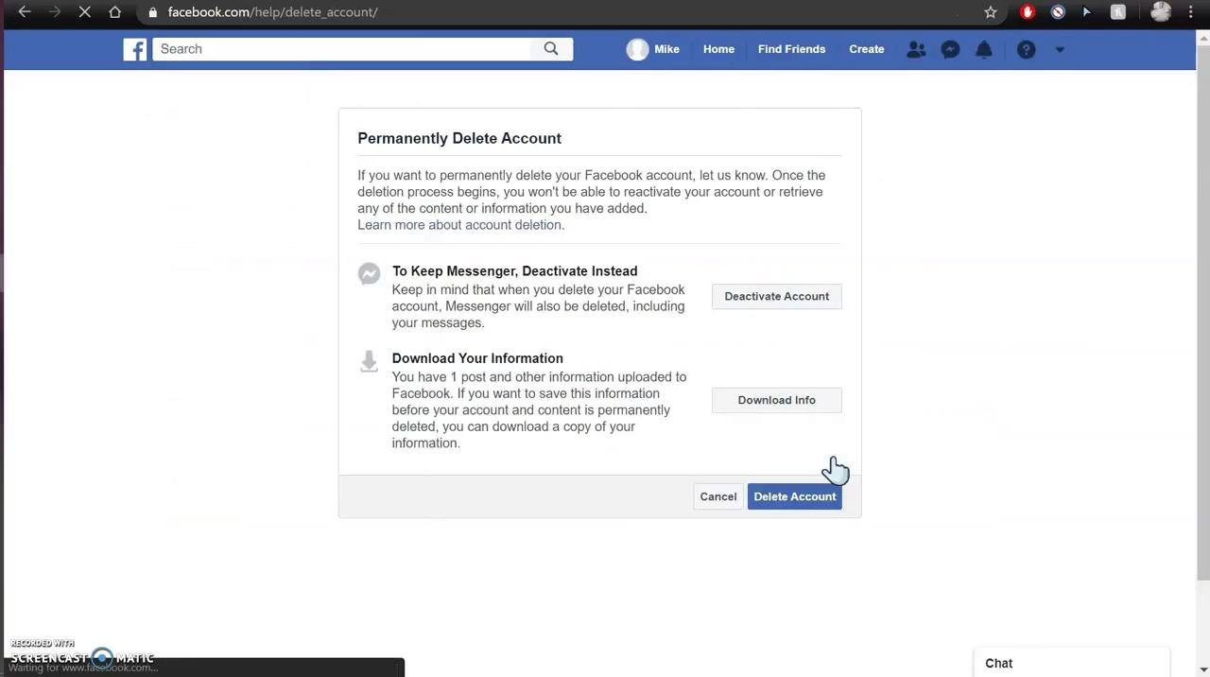
Deleting Account Video

Slide 11
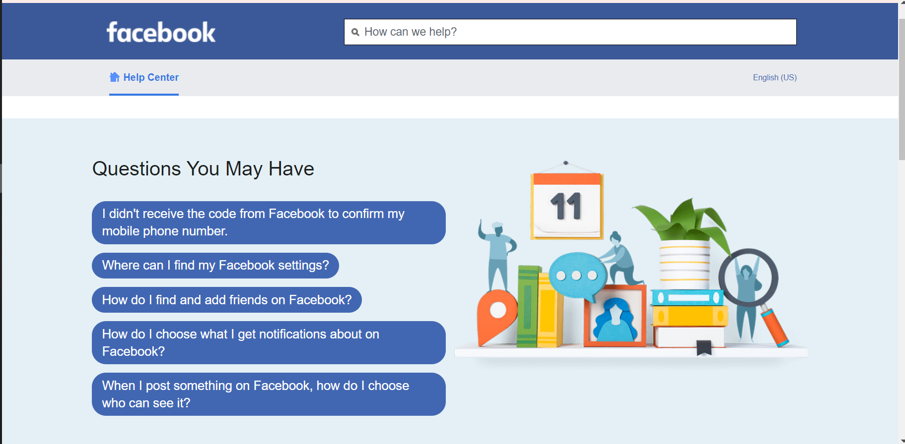
Help Section
The final section will be the help section which is a giant repository of information on the site and is there to help users out.

